Slide 1
THE BATTLE OF NEIGHBORHOODS
‘Creating your Community’

Slide 2

Background
The number of migrants into western nations such as Canada has increased exponentially
It becomes important for people to choose neighborhoods that tend to one’s sense of belonging
Scarborough, Toronto is a multicultural hub and popular destination for new immigrants
The general trend of immigration in Canada is on the rise

Slide 3
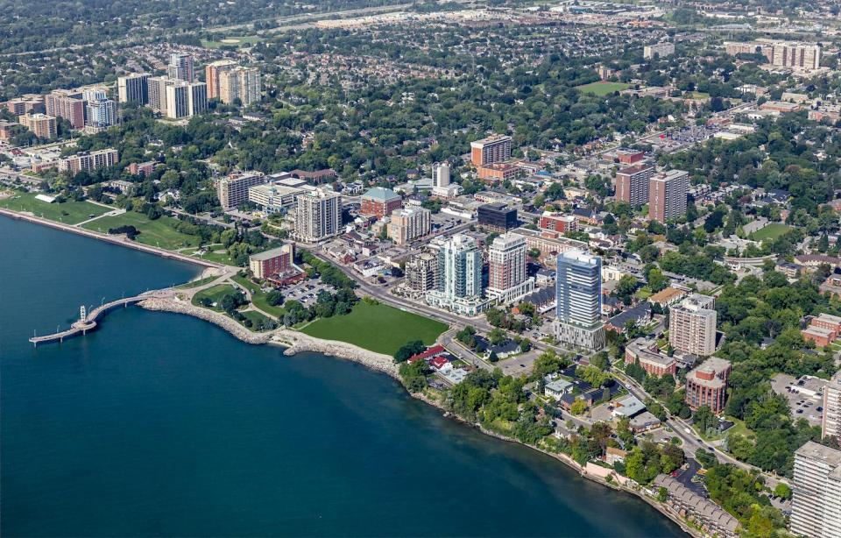

Creating Your Community
AIM: To analyze the characteristics of an ideal neighborhood of people moving to the multicultural hub of Scarborough, Toronto in comparison to other neighborhoods.
CHARACTERISTICS: Average housing price, educational facilities, crime rates, road connectivity, weather conditions, medical care/emergency facilities, freshwater resources, waste management, and recreational facilities.
ANALYSIS OF THE URBAN SECTOR:
Classification of neighborhoods based on socio-economic data
To develop and explore urban footprint expansion particularly in underdeveloped neighborhoods
Identifying urban business opportunities
To understand the intersection of multiculturalism in comparison to racially distinct communities

Slide 4

DATA
Dataset scrapped from wikipedia: latitude, longitude, zip codes
Foursquare API:
Data of different venues in the neighborhoods of a specific borough were collected
Data includes venue names, locations, menus, and photos
A radius of 100 m was chosen for each neighborhoods
The data retrieved from Foursquare contained information of venues within a specified distance of the longitude and latitude of the postcodes. The information obtained per venue are as follows:
Neighborhood
Neighborhood Latitude
Neighborhood Longitude
Venue
Name of the venue e.g. the name of a store or restaurant
Venue Latitude
Venue Longitude
Venue Category

Slide 5

Explore neighborhoods, segment them, and group them into clusters to find similar neighborhoods
Credentials of Foursquare API features of nearby places of the neighborhoods would be mined
The number of places per neighborhood parameter would reasonably be set to 100 m and the radius parameter would be set to 500 m.
The methodology for the project will include the following:
Retrieval of data, exploration, wrangling
Performing K-means clustering to analyze and segment neighborhoods
Visualization of clusters and segmented neighborhoods
Ability to understand urban growth shift patterns

Slide 6
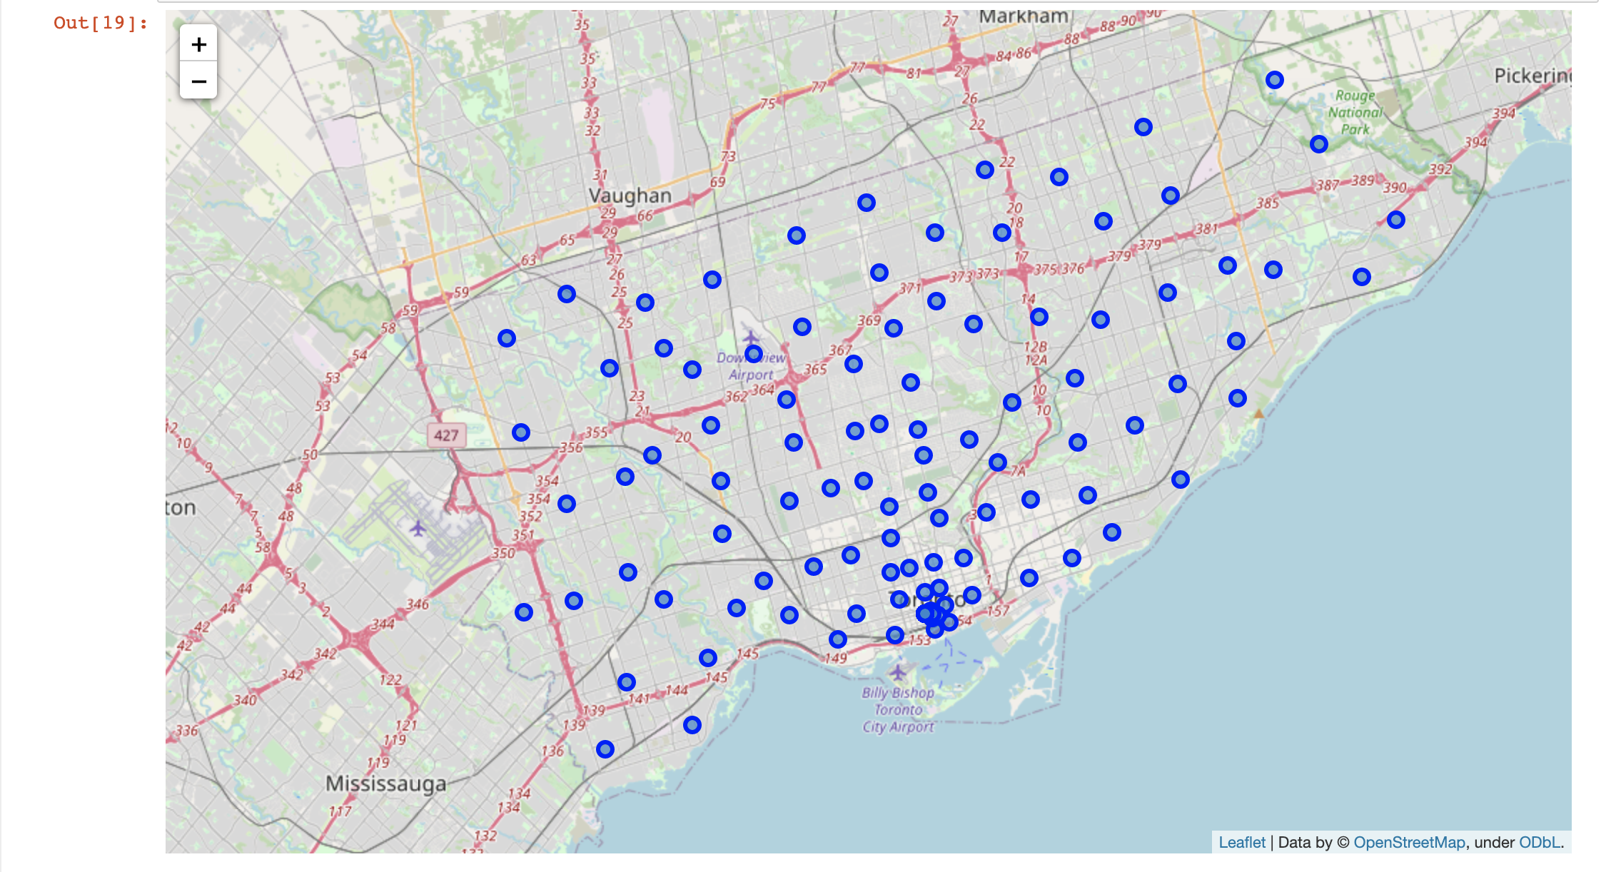
MAP OF SCARBOROUGH

Slide 7
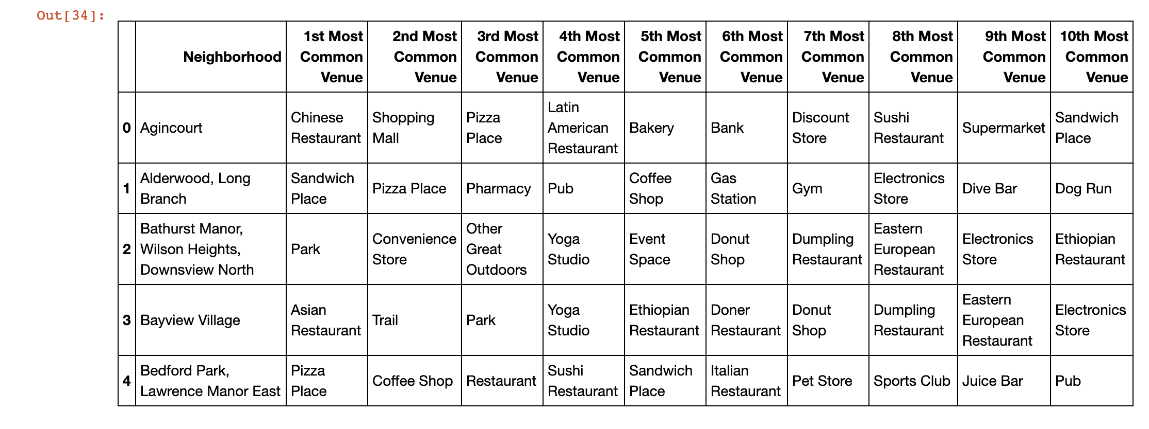
K-Means Clustering to find Common Venues

Slide 8
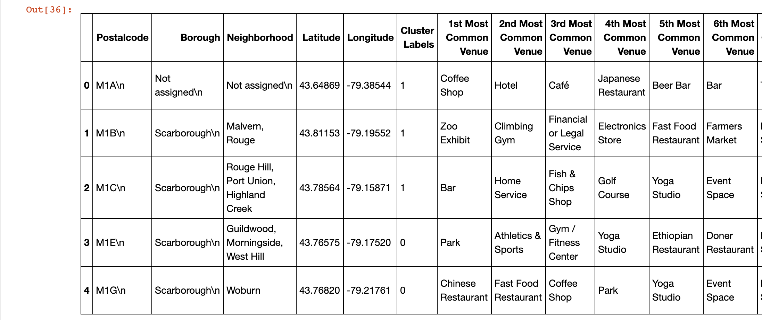
K-Means Clustering to find common venues in each neighborhood

Slide 9
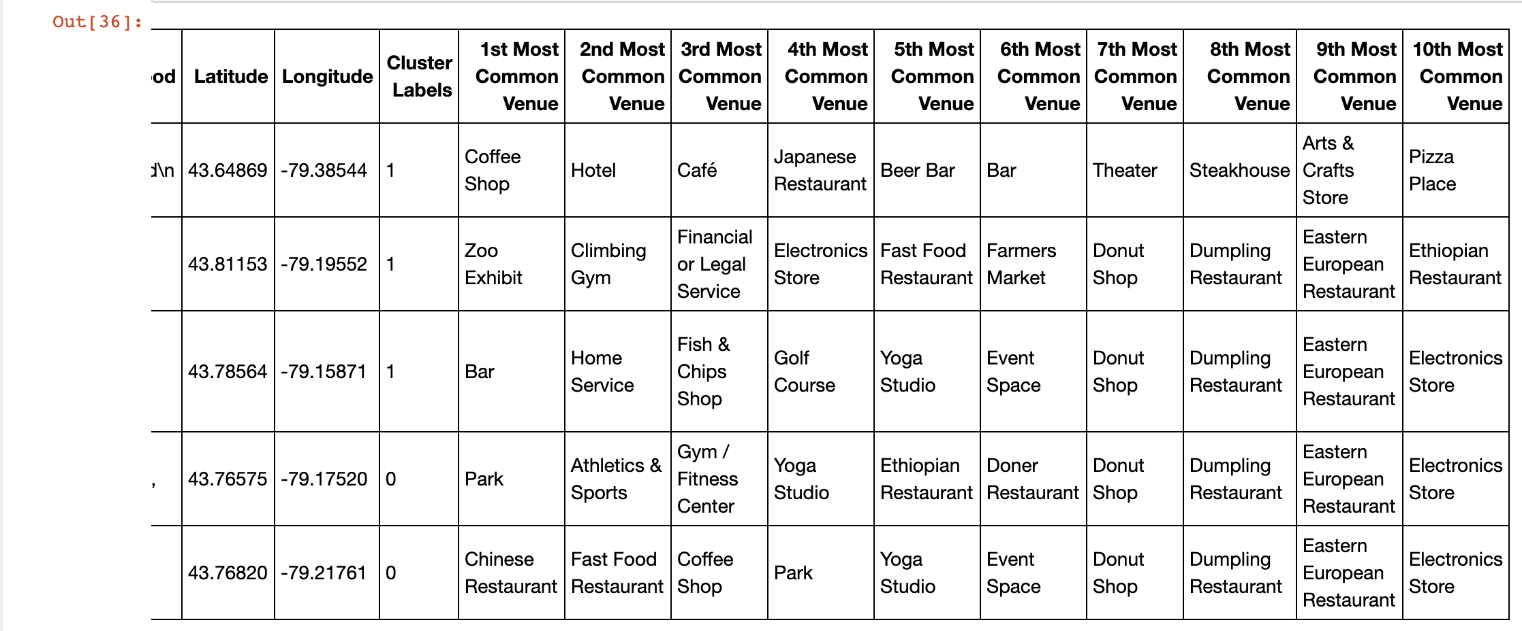
Cont’d

Slide 10
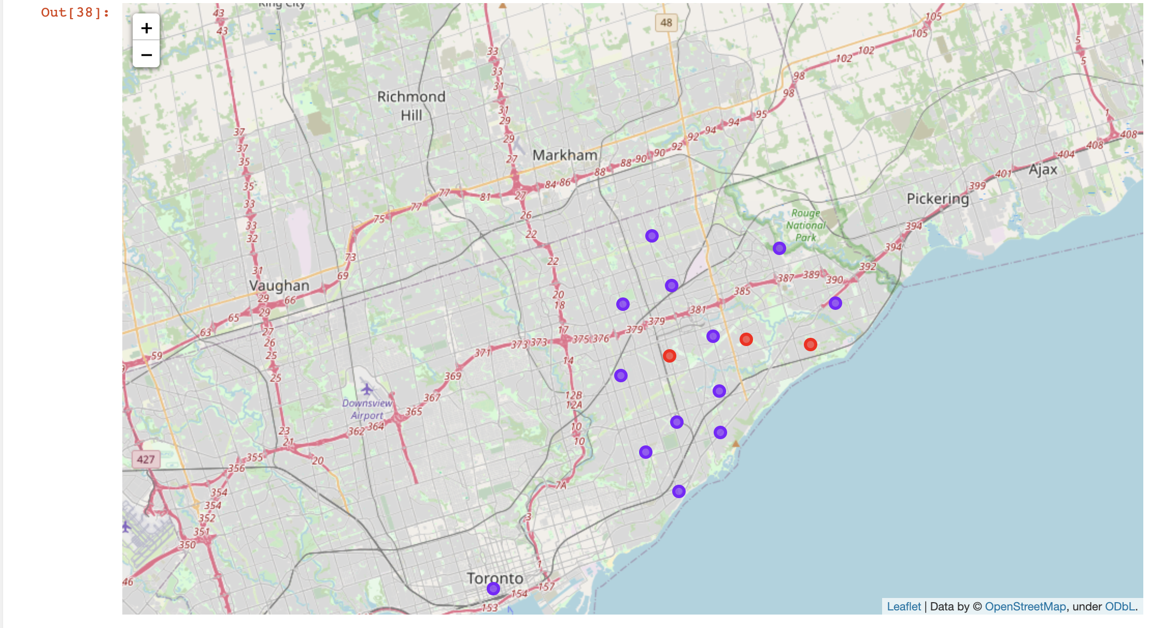
RESULTS
Map of Clusters in Scarborough
Clusters of neighborhoods with respect to mean vector points

Slide 11
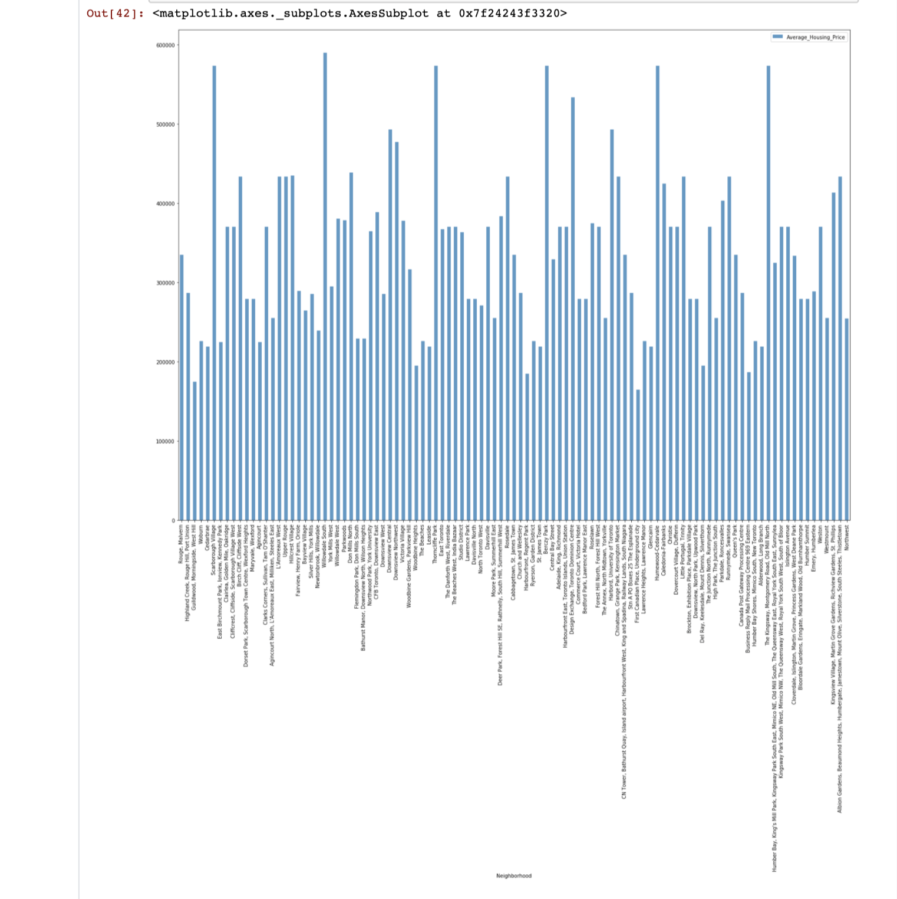
Average Housing Price of Neighborhood Clusters in Scarborough

Slide 12
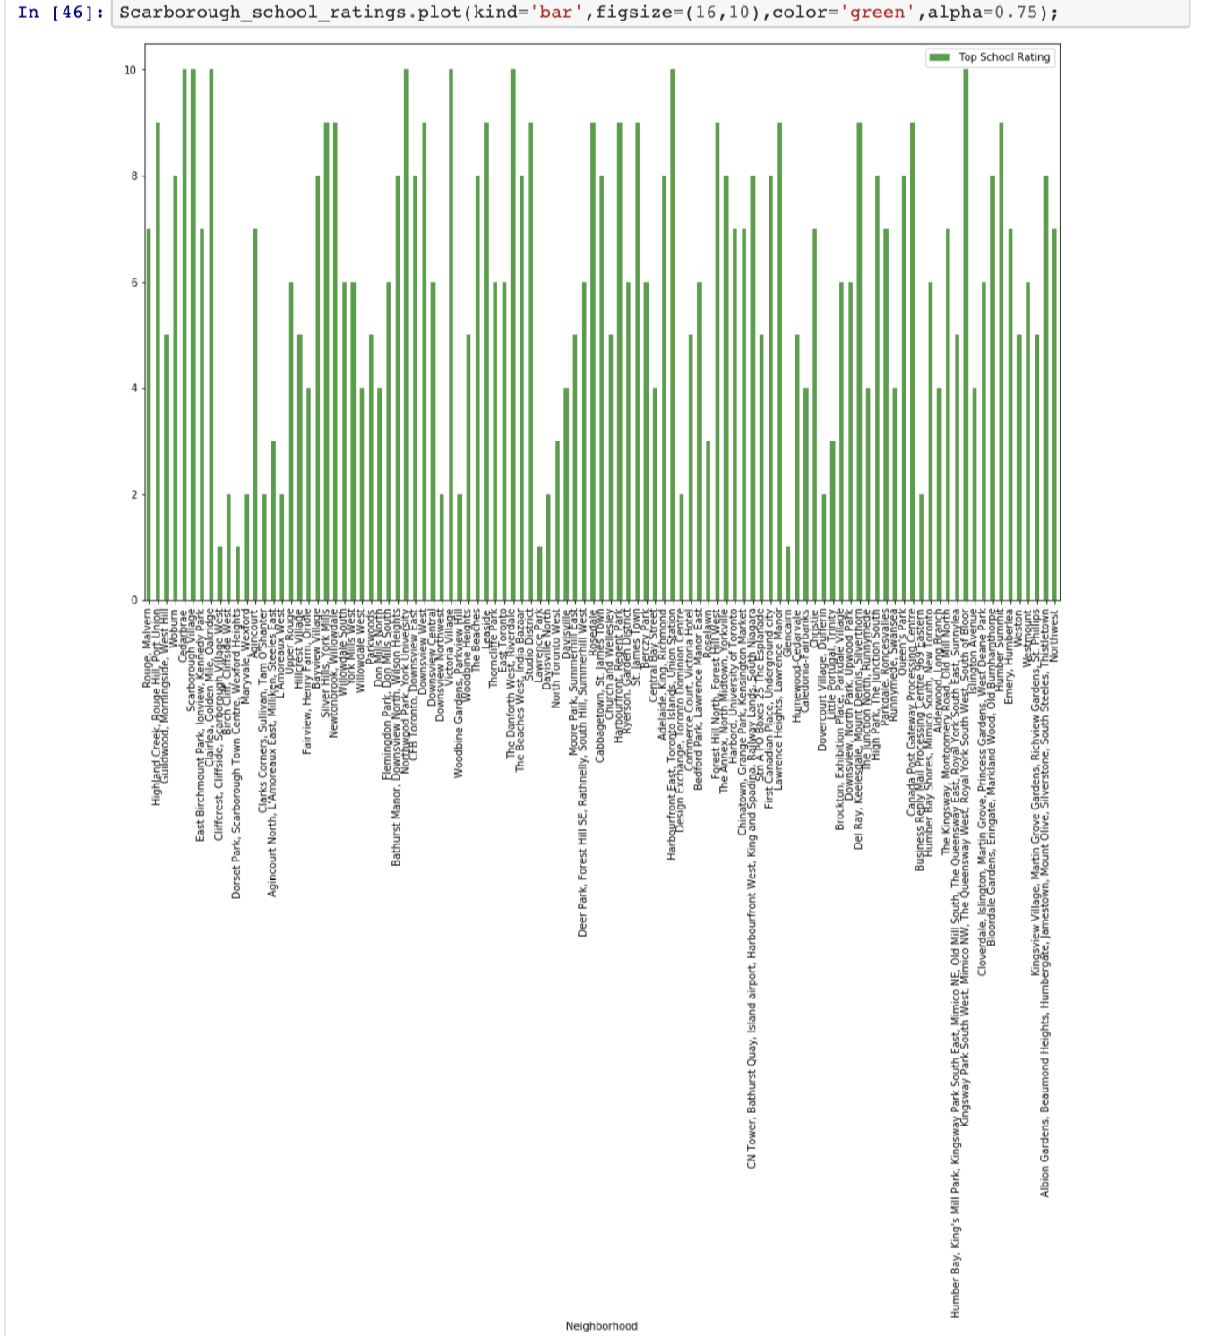
School Ratings in Scarborough as a result of Clustering

Slide 13
Discussion and Recommendations
The project suggests a neighborhood for a new resident based on accessible features of social presence, connectivity, and daily needs. The report provides the following information besides venues in Scarborough:
Housing prices in ascending or descending order
Schools in terms of locations, fees, and reviews
Venues
Recommendations:
Identify early opportunities between under developed and well developed neighborhoods
Investigations of how population segments dis-aggregate by private and non-private dwellings, age-sex, household types, enrollments and workforce status
Management of population projections, its impacts, and establish cost effective developments

Slide 14

CONCLUSION
This project successfully uses k-means clustering approach to separate the neighborhoods of Scarborough into 10 different clusters for 180 different latitude and longitude datasets and provides insights into educational, district, housing facilities and similarity of neighborhoods around them.
Hence, we were able to analyze, discover and statistically describe neighborhoods and population expansion quantitatively to identify some neighborhoods of interest.
More data about employment, workforce, population segmentation should be used for true valued quantitative analysis and predictive analytics which would be most valued by investors and developers to make appropriate investments and to minimize risk for future endeavors.

Slide 15
Report
Github link: https://github.com/harshitha9818/Coursera_Capstone/blob/master/Report%20-%20The%20Battle%20of%20Neighborhoods.ipynb
IBM Link (to view maps): https://dataplatform.cloud.ibm.com/analytics/notebooks/v2/a6623749-16e5-48b8-a9e7-b52ff6361408/view?access_token=6ac10c5f08bd31d1fe9ea3fd943fa932afe6fbd70ebd921b748c4b521a2af709
Notebook
Github link: https://github.com/harshitha9818/Coursera_Capstone/blob/master/The%20Battle%20of%20Neighborhoods%20Week%202.ipynb
IBM link (to view maps): https://dataplatform.cloud.ibm.com/analytics/notebooks/v2/bf113f7e-ad5c-44c8-93aa-46c0d6818774/view?access_token=8363681a067fecf92126801871b973eca874313b6222ea52fa47cf8027f0027e
Presentation link:
https://docs.google.com/presentation/d/1doMwGDnOhSQmeEpzxemoL5gXTbfnlzS4TFC8NW9E1c8/edit?usp=sharing

